Slide 1
PROJECT TITLE : Developing AgroServe: An Integrated Platform for Equipment Rental, Labor Services, Crop Insights, and Agricultural Market Trading
PIP104 University Project-II
Viva Voice
Batch Number:CSE-100
Roll Number | Student Name
20211CSE0573 | Sannidhi N C
20211CSE0557 | Deepthi A
20211CSE0544 | M Naveen Reddy
20211CSE0549 | Korapathi Keerthan Reddy
Under the Supervision of,
Dr. Jinesh V N
Assistant Professor
School of Computer Science & Engineering
Presidency University

Slide 2
Introduction
Abstract:
AgroServe is considered a new-age website aimed at assisting farmers and facilitating agricultural activities. It includes four services: agricultural machinery rental services, labor services, crop advisory services, and market for agricultural products. Farmers can rent equipment, hire labor, receive reports on the condition of plants and sell their fruits – all without leaving the platform it also includes Agro tourism. The ambition of AgroServe is to ensure that these processes are effective as well as saving time and manpower while making decisions and using resources in a way that will be conducive to environmentally friendly and sustainable agriculture and rural growth.

Slide 3
Literature Review
Equipment Rental in Agriculture: Agricultural mechanization is a key driver for increasing farm productivity, yet many small-scale farmers face challenges in affording expensive machinery. Singh et al. (2020) highlight that equipment rental platforms offer a cost-effective alternative, allowing farmers to rent machinery like tractors and harvesters. AgroServe enhances this approach by providing a mobile-based platform where farmers can easily access a variety of equipment to meet their specific needs.
Labor Services in Agriculture: Labor shortages, driven by rural-urban migration and the aging farming population, are a pressing issue in agriculture. Bhattacharya and Mukherjee (2019) emphasize that digital labor platforms can bridge the gap between demand and supply, particularly during critical farming seasons. AgroServe integrates labor services into its platform, enabling farmers to hire skilled or unskilled labor through a seamless and efficient process.

Slide 4
Literature Review
Crop Insights and Decision-Making: The use of data analytics, AI, and IoT has transformed agricultural practices by providing real-time insights into crop health, soil conditions, and pest management.
Gupta et al. (2021) suggest that these technologies help farmers make informed decisions, optimize fertilizer usage, and improve yields. AgroServe includes a crop insights feature that offers personalized recommendations for better crop management, based on real-time data.
Agricultural Market Trading: Farmers often struggle to access markets directly, resulting in reduced profits due to middlemen. Digital agricultural marketplaces help farmers sell their produce at competitive prices and reach a broader customer base. According to Sharma et al. (2019), platforms that connect farmers directly to markets enhance transparency and profitability. AgroServe’s market trading feature empowers farmers by enabling direct market participation, reducing reliance on intermediaries.
Agro-Tourism: Agro-tourism promotes rural development by connecting urban visitors with farming experiences, providing farmers with additional income and fostering cultural exchange. Patel et al. (2020) highlight that sustainable agro-tourism enhances livelihoods and awareness of eco-friendly practices. AgroServe supports agro-tourism by linking farmers with tourists, offering farm-stays, hands-on experiences, and local products, boosting income and sustainability.

Slide 5
Research Gaps in AgroServe Development
Research Gaps
Lack of a comprehensive platform integrating rental, labor, insights, trading and agro tourism.
Absence of real-time recommendations based on local conditions (e.g., soil, climate).
Limited access to affordable multi-language interfaces for rural farmers.Insufficient use of advanced technologies like AI, IoT, and drones in agricultural decision-making.
Gaps in payment transparency and cost optimization for equipment and labor rentals.

Slide 6
Proposed Methodology
Requirement Gathering:
Identify key functionalities: equipment rentals, labor services, crop insights, and agricultural trading. Understand user needs to make the platform farmer-friendly.
System Design: Develop a clear and intuitive user interface. Plan backend architecture for seamless data management.
Development:
Frontend: Design using Visual Studio Code for HTML, CSS, and JavaScript.
Backend: Implement logic in Python Django using PyCharm.
Database: Store and manage data with MySQL in XAMPP.
Testing: Perform functionality and usability testing. Refine based on user feedback.

Slide 7
Methodology
Requirement Analysis Identify essential features: Equipment rentals, labor services, crop insights, agro-tourism, and market trading. Understand user needs to design a farmer-friendly interface. Plan backend processes and database requirements for effective data management.
System Design Frontend Design: Use PyCharm and Visual Studio Code for user interface development. Create sections for rentals, labor, crop insights, market trading, and agro-tourism.
Backend Development: Use Python Django to implement business logic and manage feature interactions.
Recommendation Systems:
Crop Insights: Implement a recommendation system using the Random Forest algorithm to provide suggestions for: Suitable fertilizers and pesticides. Ideal climatic conditions for crops.
Market Trading: Use the Random Forest algorithm to recommend optimal pricing and trading opportunities based on: Market demand, Historical data and trends, Methodology.
Development:
Frontend: Use HTML, CSS, and JavaScript to design interactive and responsive pages.
Backend: Develop features for managing equipment rentals, labor services, and crop insights using Django.

Slide 8
Methodology
Database Management: Use MySQL in XAMPP for efficient data storage, including user details, equipment availability, labor bookings, and crop data.
Integration of Features
Equipment Rentals: Add a catalog with real-time availability and pricing.
Labor Services: Enable batch booking and scheduling for agricultural labor.
Agro-Tourism: List tours with descriptions, locations, and pricing details.
Market Trading: Create a platform for buying and selling crops with pricing recommendations.
Testing and Validation: Perform functionality and usability testing for each module. Validate the accuracy of recommendation systems using testing datasets. Conduct user feedback sessions to refine the platform.
Deployment and Maintenance: Deploy the application on a local server for easy access. Provide regular updates to improve features and integrate additional recommendations as needed.

Slide 9
Objectives
Empowering Farmers:
Provide easy access to equipment rentals and labor services.Offer plant-specific insights on fertilizers, pesticides, and climate.
Enhancing Agricultural Practices:
Simplify crop trading through an integrated marketplace.Encourage adoption of modern farming techniques.
Promoting Agro Tourism:
Introduce a dedicated section for agro-tour packages.Allow tourists to explore farming practices and rural experiences.
Simplifying Processes:
Create a user-friendly platform for efficient farming.Reduce manual effort through a centralized digital system.

Slide 10
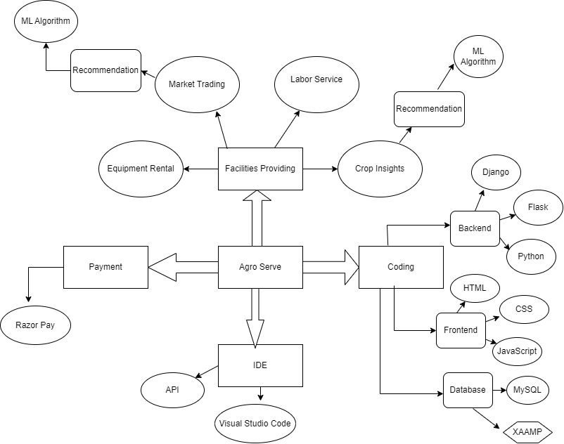
System Design and Implementation

Slide 11
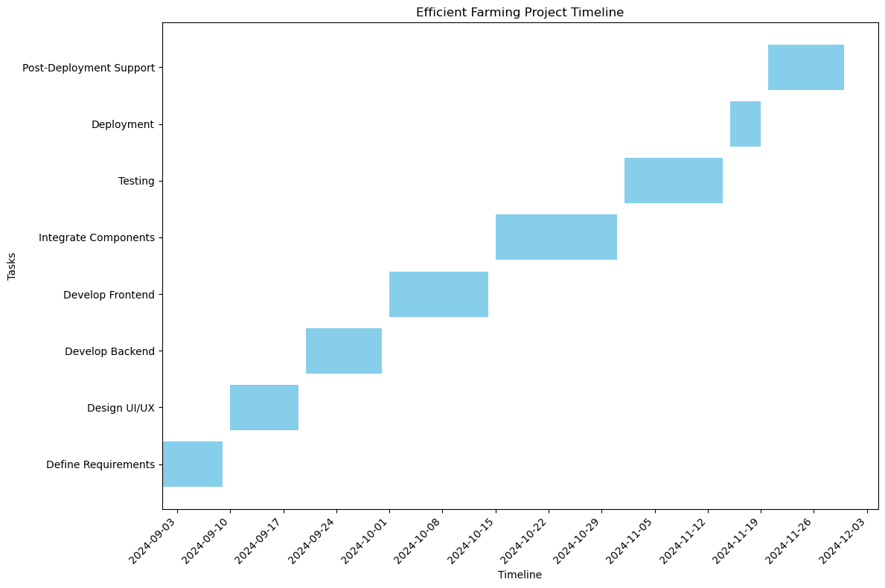
Timeline of Project

Slide 12
Outcomes
Enhanced Farming Efficiency:
Farmers gain easy access to equipment rentals and labor services, reducing manual effort and improving productivity.
Accurate Crop Insights:
The recommendation system provides tailored suggestions for fertilizers, pesticides, and climatic conditions, leading to healthier crops and higher yields.
Improved Market Access:
A seamless trading platform with price recommendations helps farmers make informed decisions, ensuring better profits.

Slide 13
Outcomes
Promotion of Agro-Tourism:
The agro-tourism feature attracts tourists, promoting rural culture and generating additional income for farmers.
Increased Digital Adoption:
The platform encourages farmers to embrace technology, bridging the gap between traditional and modern farming practices.
Positive Environmental Impact:
Efficient resource usage through tailored recommendations reduces wastage of fertilizers and pesticides.

Slide 14
References
Rakhra, Manik, et al. "[Retracted] Implementing Machine Learning for Smart Farming to Forecast Farmers’ Interest in Hiring Equipment." Journal of Food Quality 2022.1 (2022): 4721547.
Pradhan, Shradhanjalee, and Bibhuti Bhusan Sahoo. "Enhancing Water Efficiency in Modern Farming: Innovations for Sustainable Agriculture.“
Oh, Soojin, and Chungui Lu. "Vertical farming-smart urban agriculture for enhancing resilience and sustainability in food security." The Journal of Horticultural Science and Biotechnology 98.2 (2023): 133-140.
Sharma, Vivek, Ashish Kumar Tripathi, and Himanshu Mittal. "Technological revolutions in smart farming: Current trends, challenges & future directions." Computers and Electronics in Agriculture 201 (2022): 107217.

Slide 15
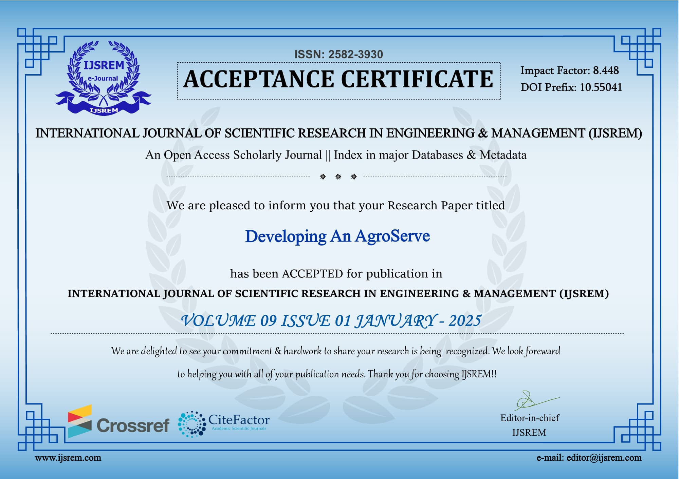
Publication Details
Published Website:INTERANTIONAL JOURNAL OF SCIENTIFIC RESEARCH IN ENGINEERING AND MANAGEMENT IJSREM

Slide 16
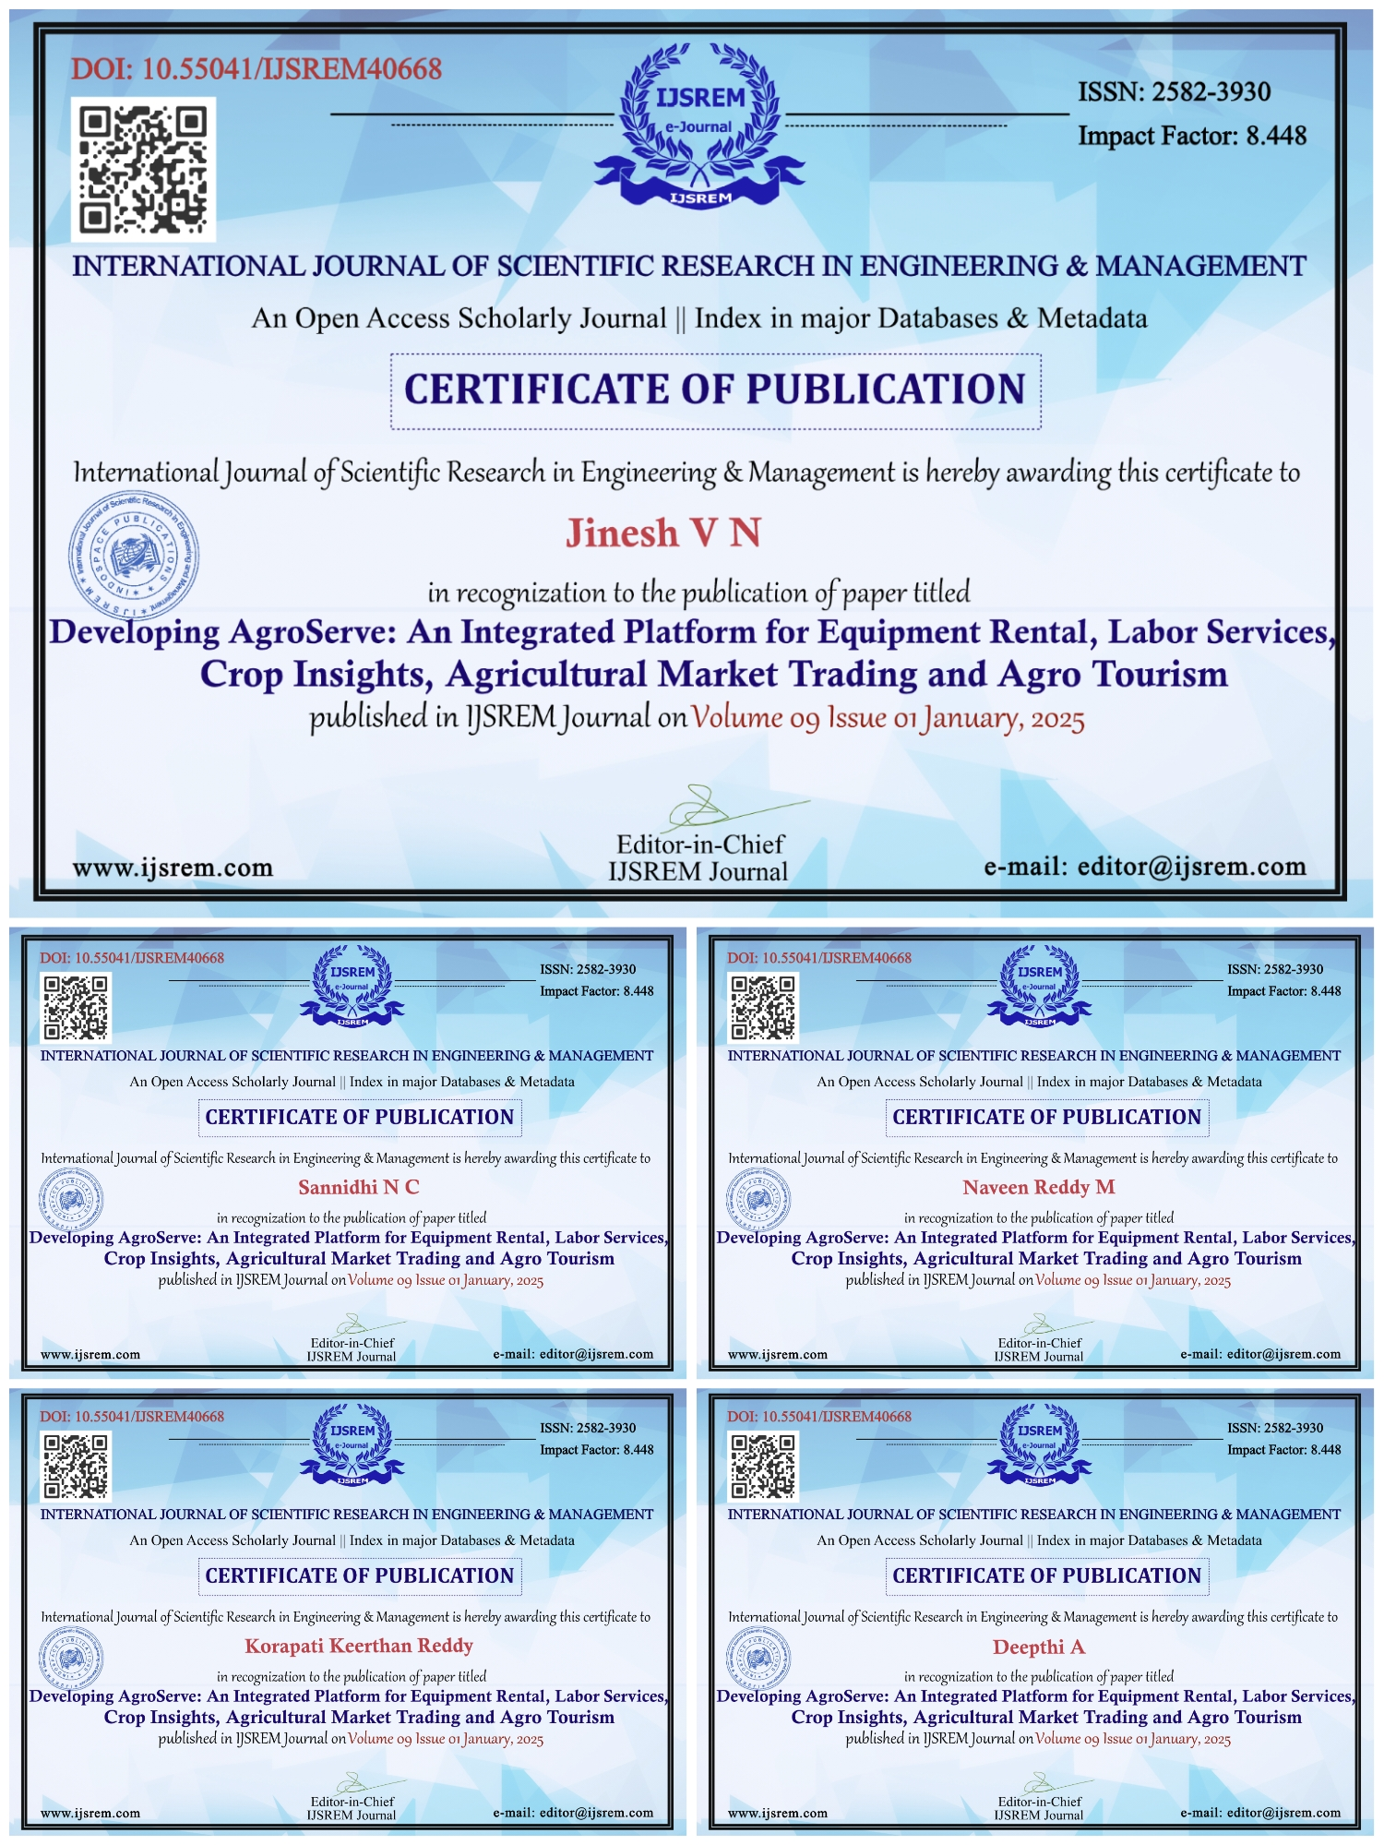
Achievements
Published Website:INTERANTIONAL JOURNAL OF SCIENTIFIC RESEARCH IN ENGINEERING AND MANAGEMENT IJSREM

Slide 17
Thank You

